Slide 1
From Super-Size to Super Crisis: The Obesity Epidemic in the USA
Amit Singh

Slide 2
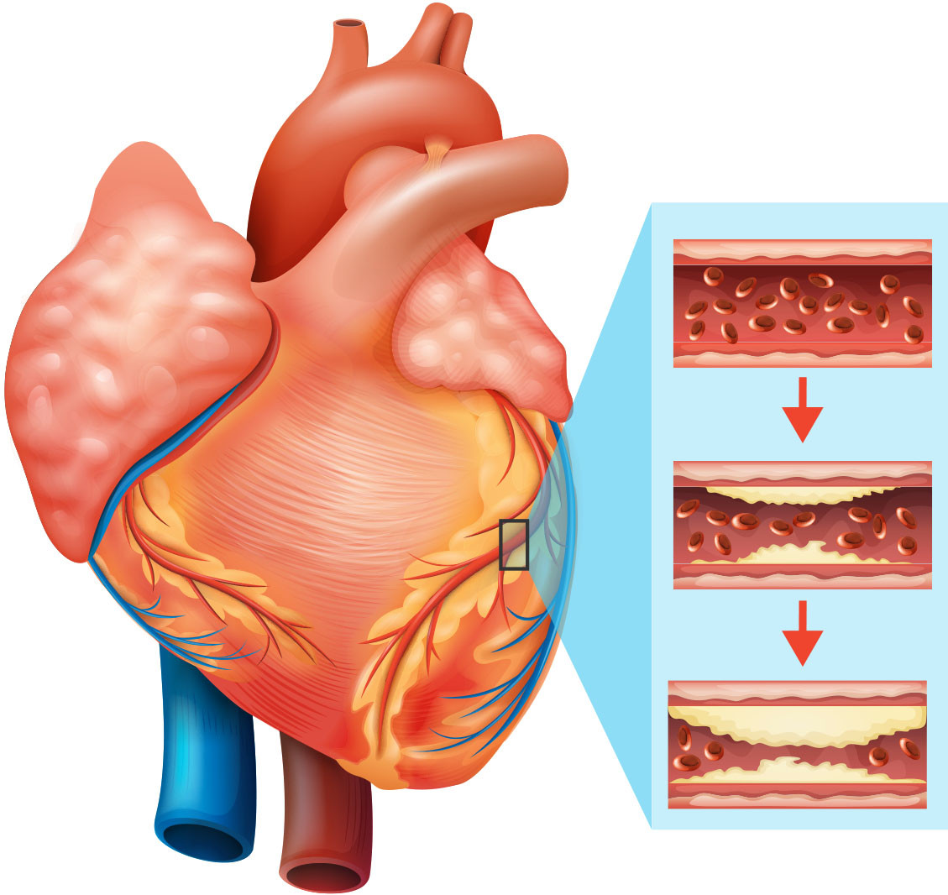
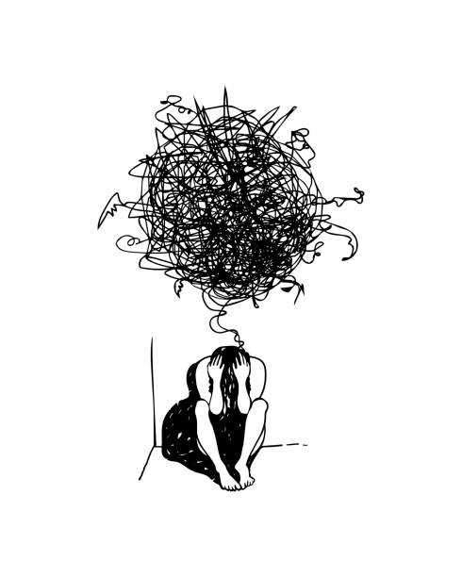
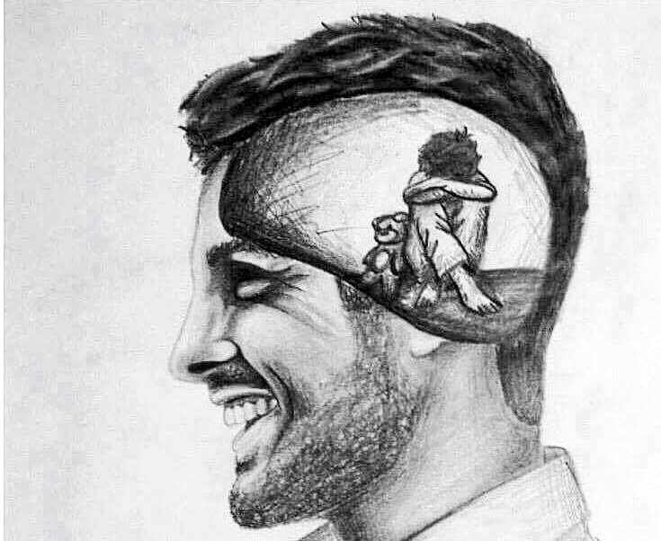
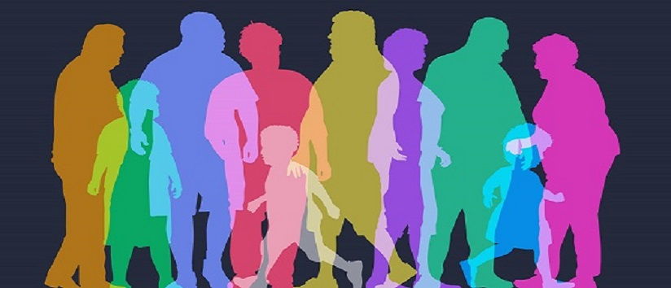
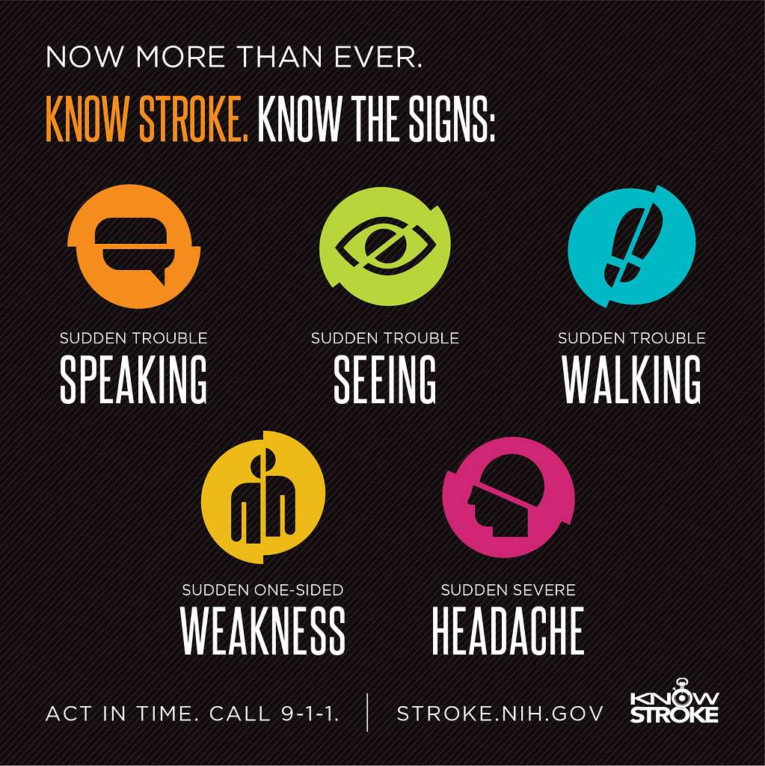
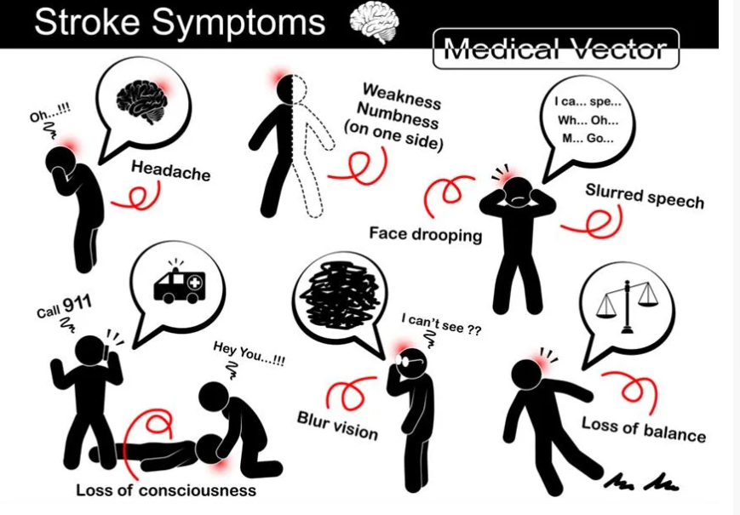
Obesity: The Weight of Emotions
Obesity has become a public health crisis starting in the latter half of the 20th century affecting both adults and children across various demographics
Health Complications - Increased in type 2 diabetes, heart disease, depression, stroke, leading to increase morbidity and mortality.

Slide 3
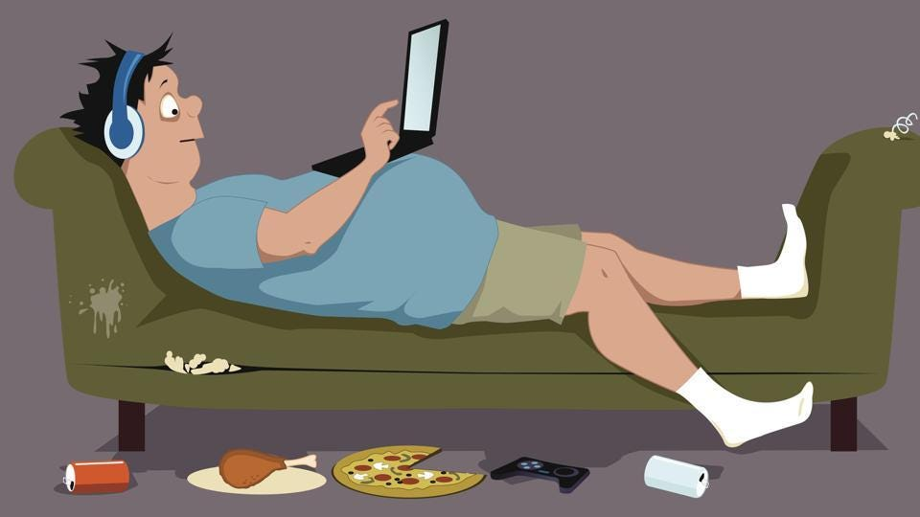
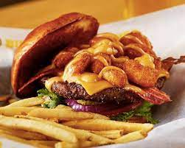

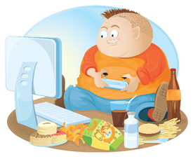


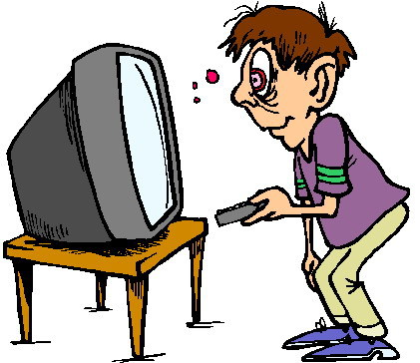
Living Large: Lifestyle and Diet
Lifestyle and Dietary Factors – Sedentary lifestyles, high intake of calorie dense, processed foods, and decrease physical activities, plus modern form of entertainment have been key contributors.

Slide 4

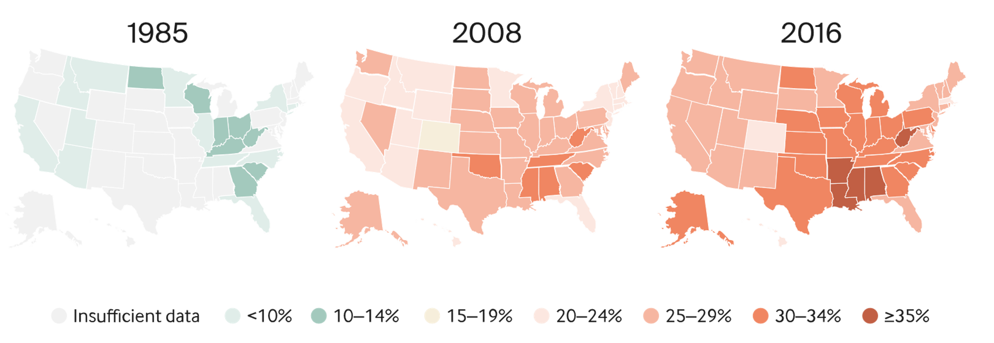


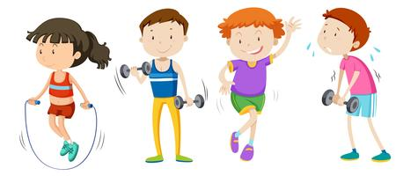
Drain on the Economy and Society
Economic and Social Impact – Increase healthcare cost for obesity related illnesses. There are social issues such has mental health for those who are affected.
Public Challenge – There are ways to combat this epidemic by promoting healthier eating, physical activity and awareness about the risk of obesity.

Slide 5
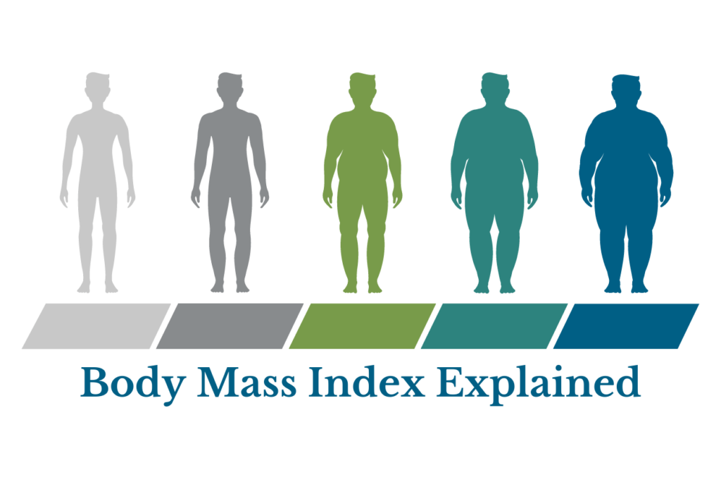
Measuring Obesity: BMI
Crunching The Numbers
Calculating Obesity
Obesity is a complex and widespread health issue with serious consequences.
It is characterized by excessive body fat accumulation, often measured using Body Mass Index (BMI).

Slide 6
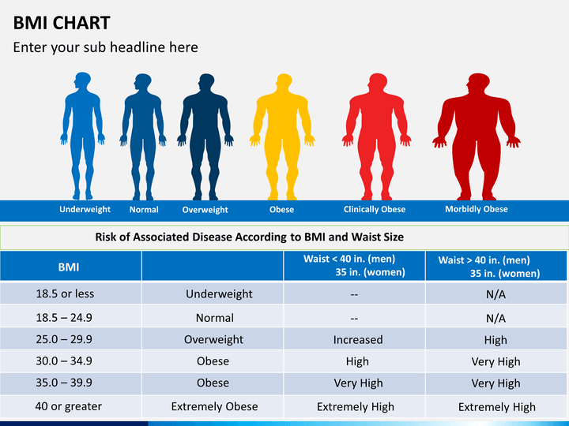
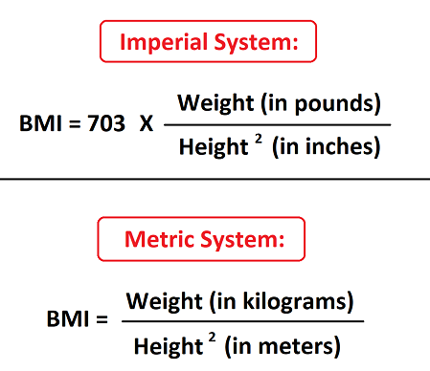
Mathematics of Obesity
Calculating Obesity
BMI is a common tool for assessing obesity. It's calculated by dividing weight in kilograms by the square of height in meters (BMI = weight (kg) / height (m^2)).
BMI categories:
Underweight (BMI < 18.5)
Normal weight (BMI 18.5 - 24.9)
Overweight (BMI 25 - 29.9)
Obesity (BMI ≥ 30)
Severe obesity (BMI ≥ 40)

Slide 7
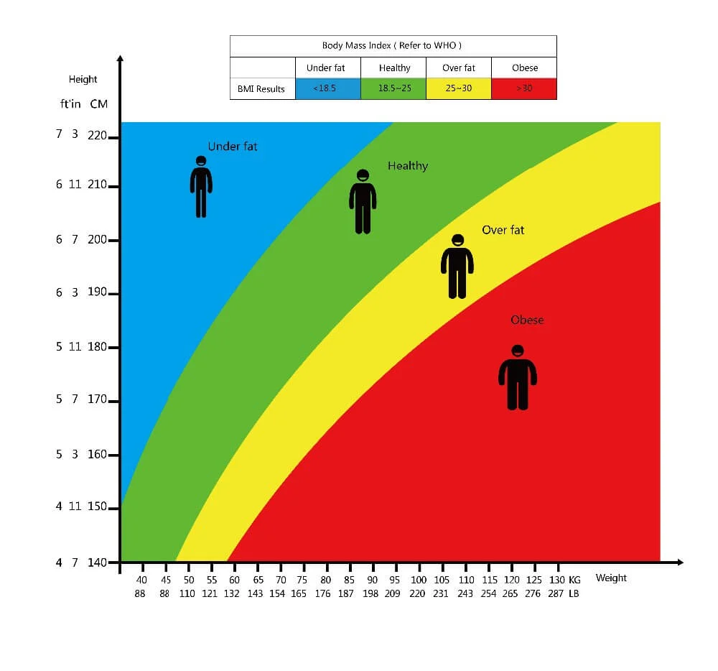
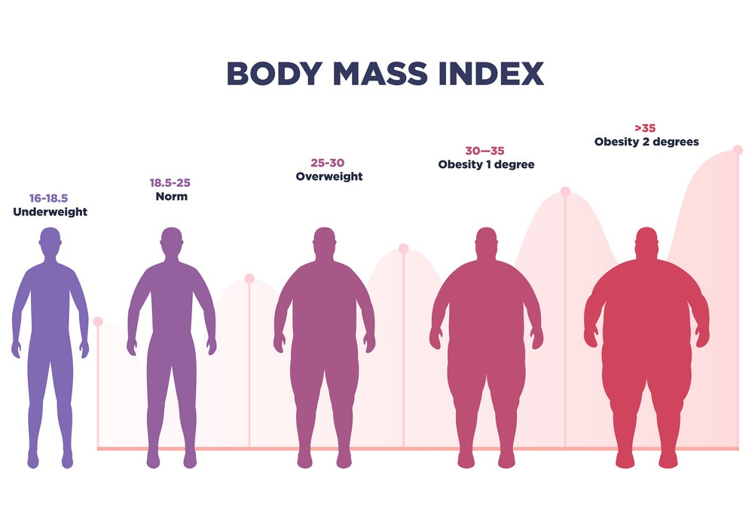
Obesity Epidemic in US

Slide 8

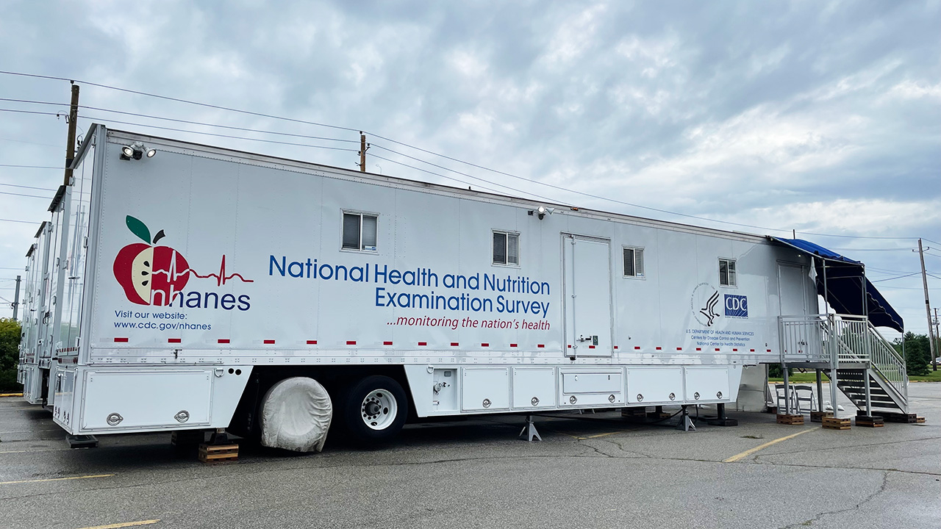
Diving Into The Data
NHANES Continuous Data Set from 1999-2018
The National Health and Nutrition Examination Survey (NHANES) is a program that assesses the health and nutritional status of adults and children in the U.S., conducted by the National Center for Health Statistics.
NHANES combines interviews and physical examinations to provide data on disease prevalence, risk factors, nutritional status, and health disparities.
The survey's findings are essential for developing health policies and programs and for understanding trends in health and nutrition in the American population.

Slide 9

Deeper Dive: Insights Beneath The Surface
BRFSS Data Set from 2018-2022
The Behavioral Risk Factor Surveillance System (BRFSS) is the largest continuous conducted health survey system in the world. Conducted by the CDC and it collects data annually from the United States.
The survey is conducted via telephone interviews which is critical for understanding and addressing local public health. BRFSS completes more than 400,000 adult interviews each year.
It plays a role in shaping public health initiatives and policies by providing valuable insights into the health behaviors of United States.

Slide 10
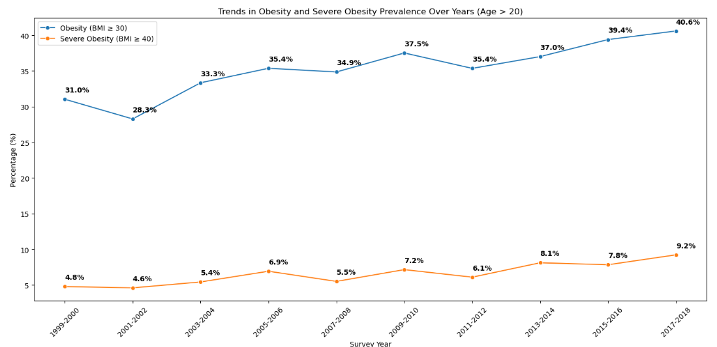
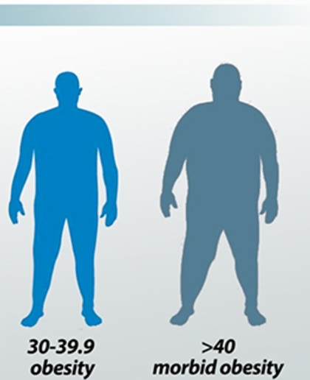
The Heavy Truth
Obesity BMI > 30 and Severe Obesity BMI > 40

Slide 11
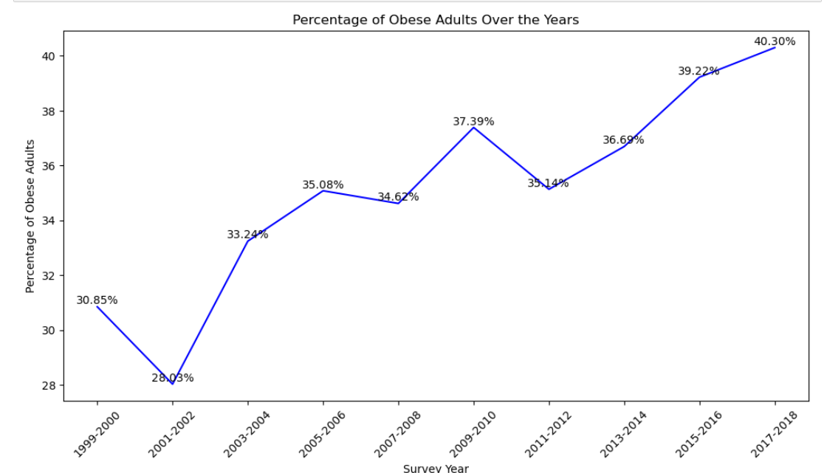
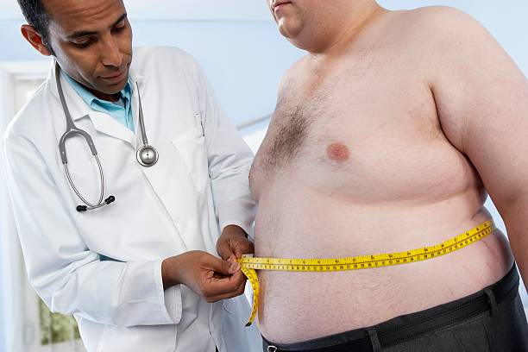
Weight of Responsibility

Slide 12
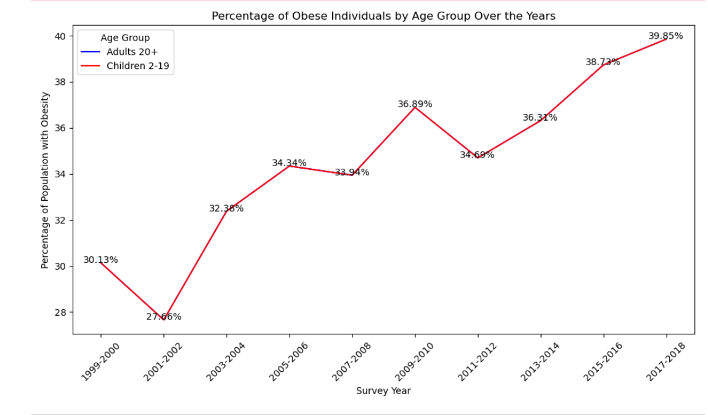
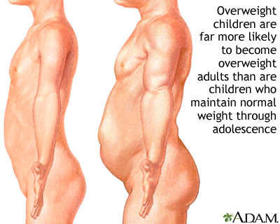
Healthy Future? A Parental Warning

Slide 13
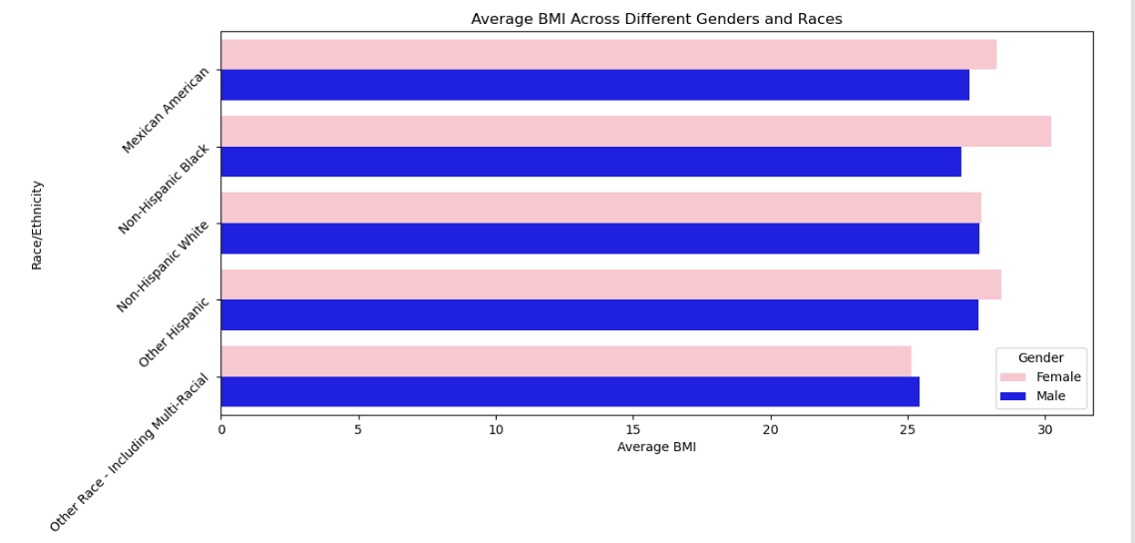
Gender and Race Matters In Obesity

Slide 14
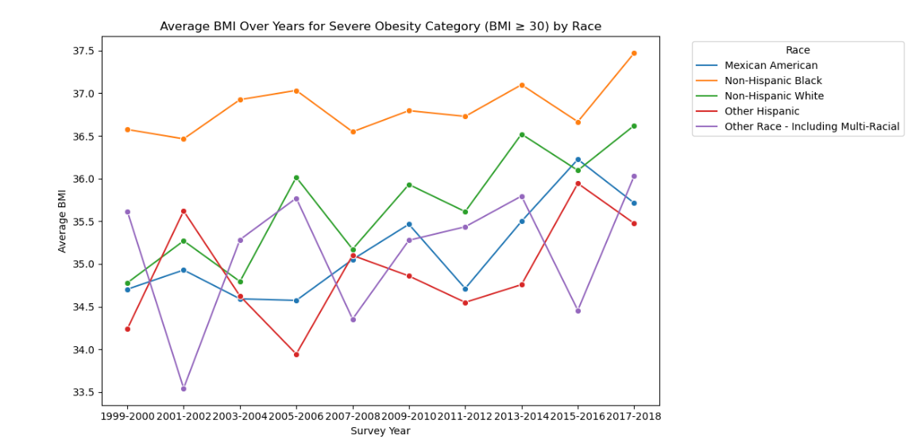
Obesity in Multicultural America

Slide 15
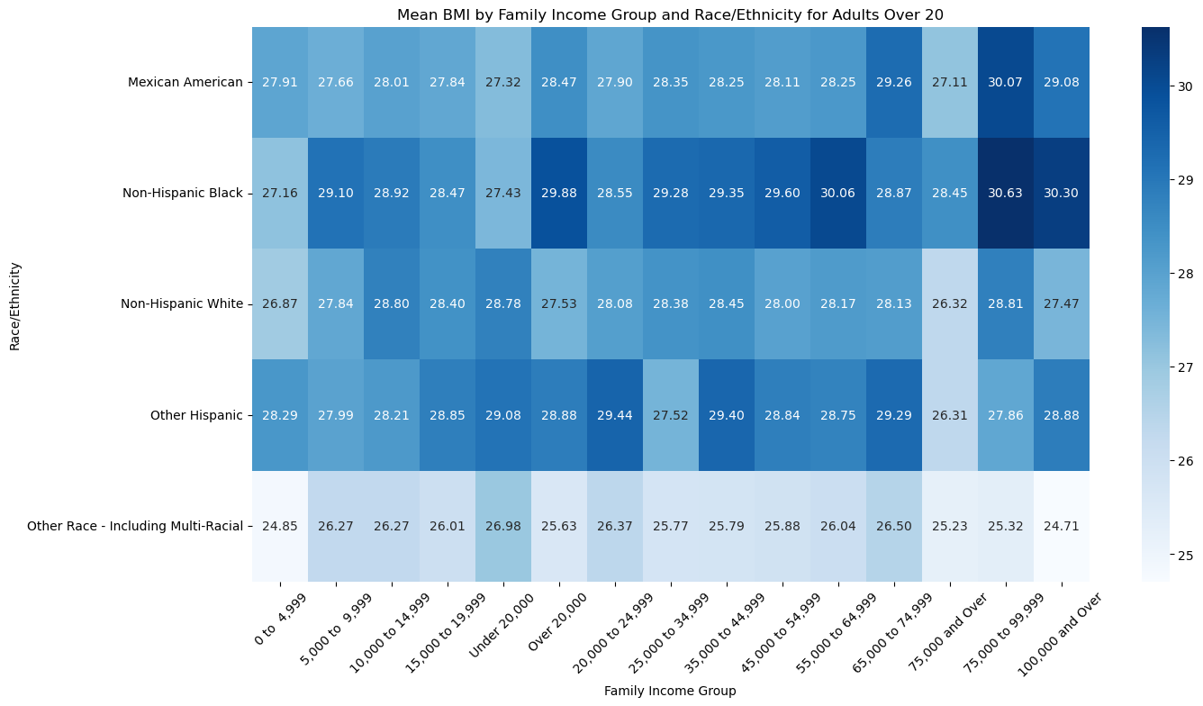
Obesity, Race, Income: The Intersection

Slide 16
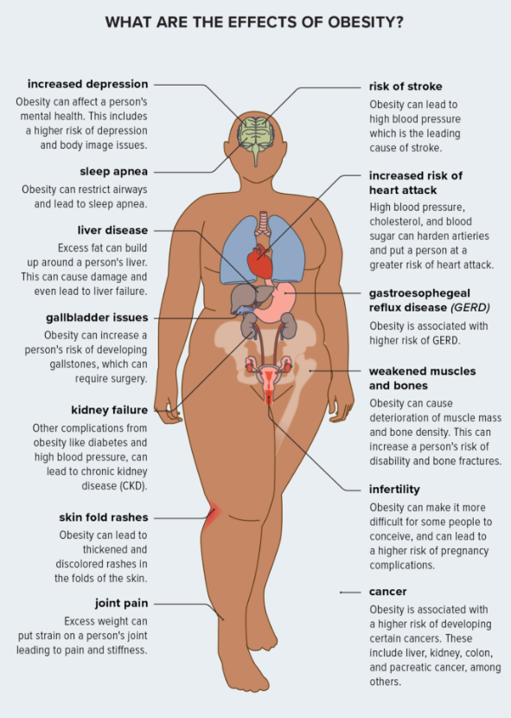
Body in Crisis: Beneath the Surface
Things We Can Control
Cardiovascular
Diet
Exercise
Mental Health
Sleep

Slide 17
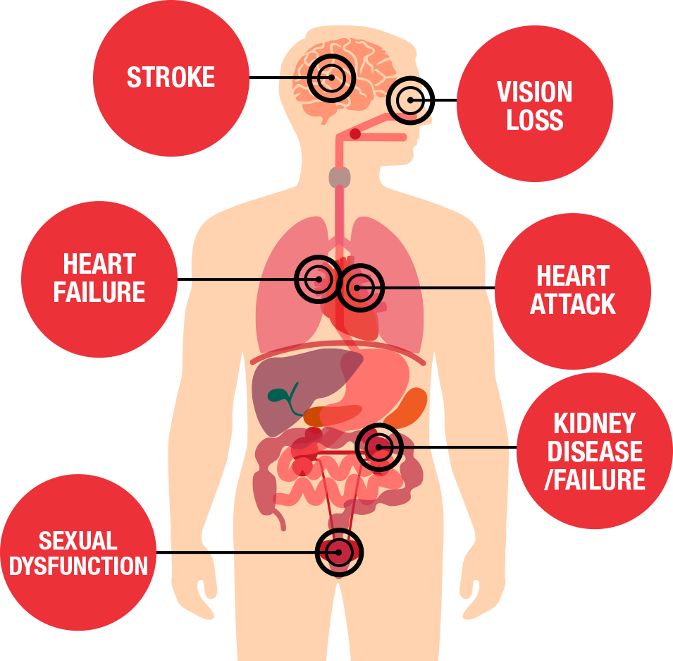
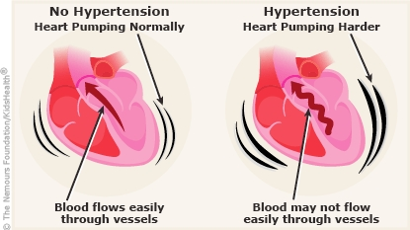
Obesity breaking the Pressure Barrier
Blood Pressure vs Hypertension
Side Effects of Hypertension
Blood pressure - is the pressure that the blood pushing against the wall of your arteries. Like a water pipe.
Hypertension - elevated pressure in the arteries which can increase the risk of heart disease, stroke and other medical problems.

Slide 18
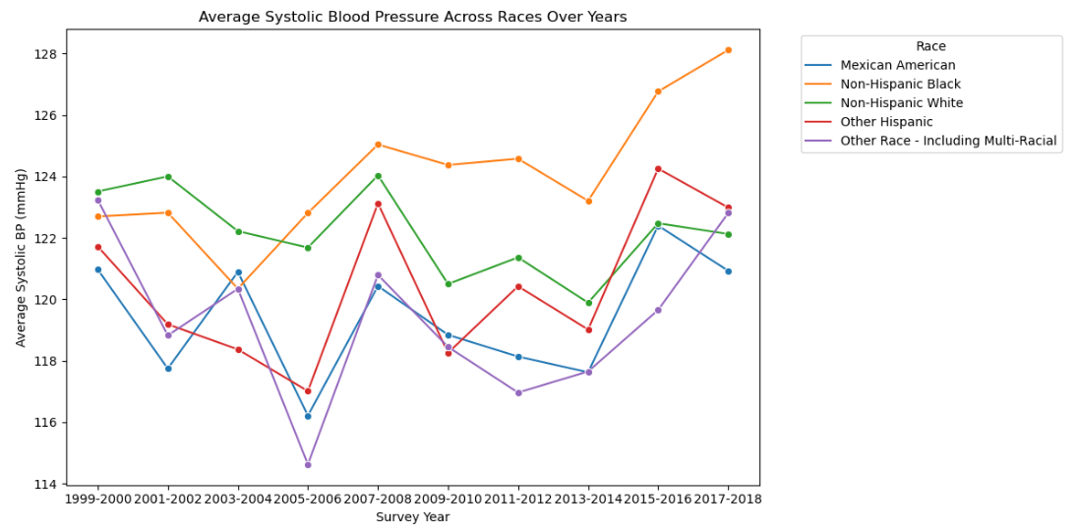
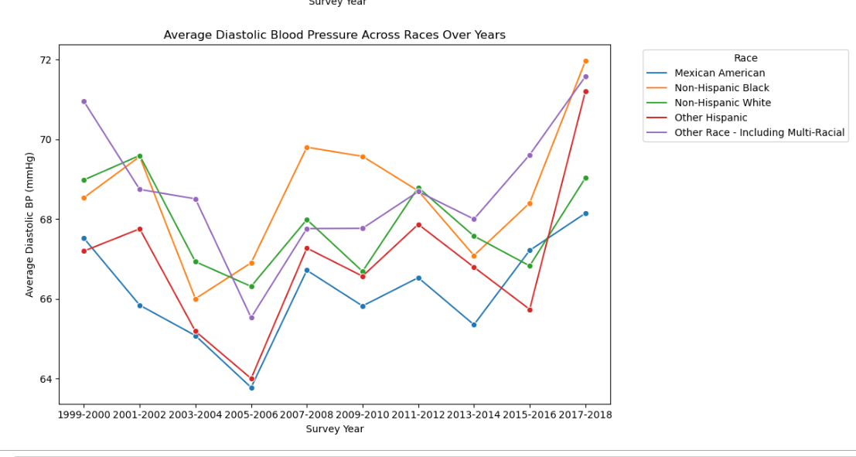
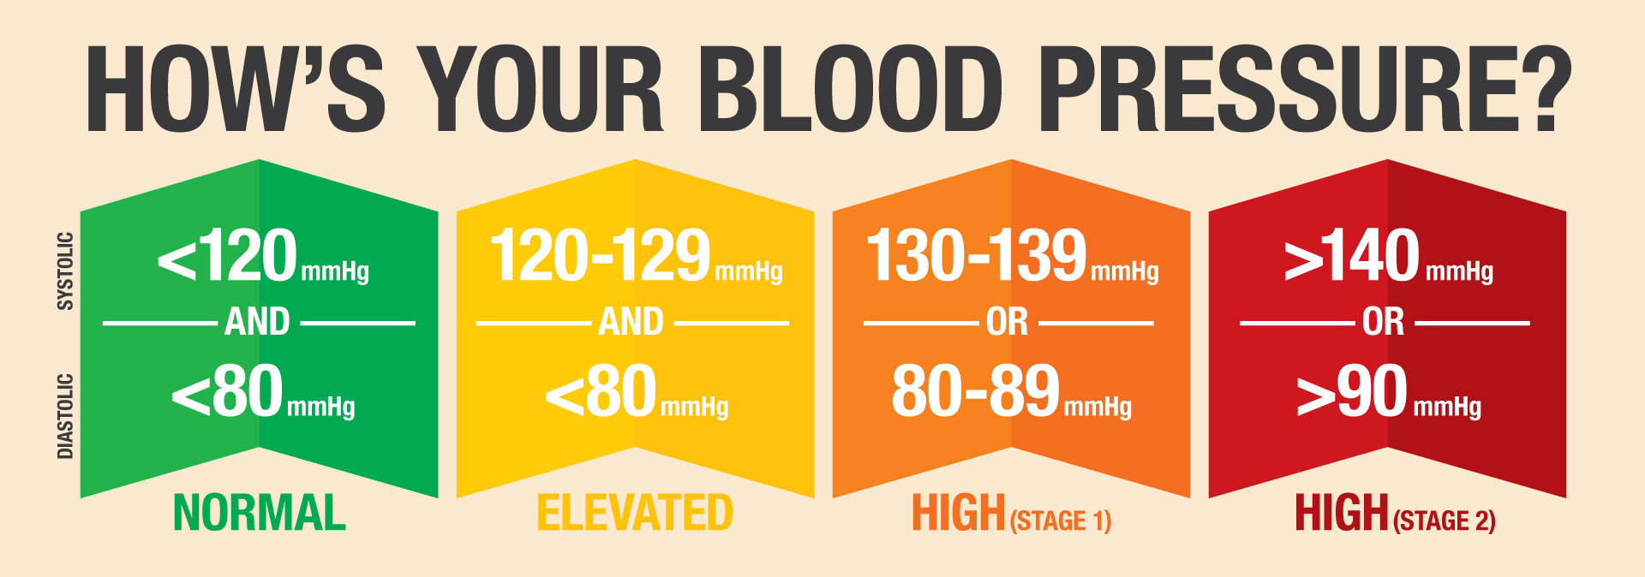
Heart Pump Between Ethnic Groups

Slide 19
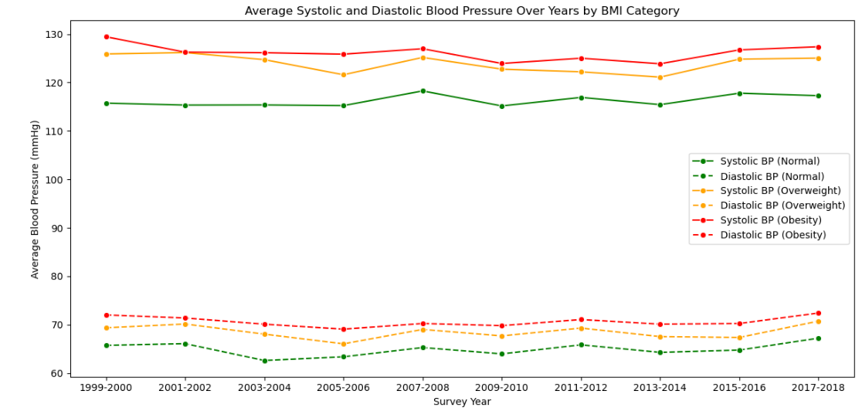
Weight of Hypertension

Slide 20
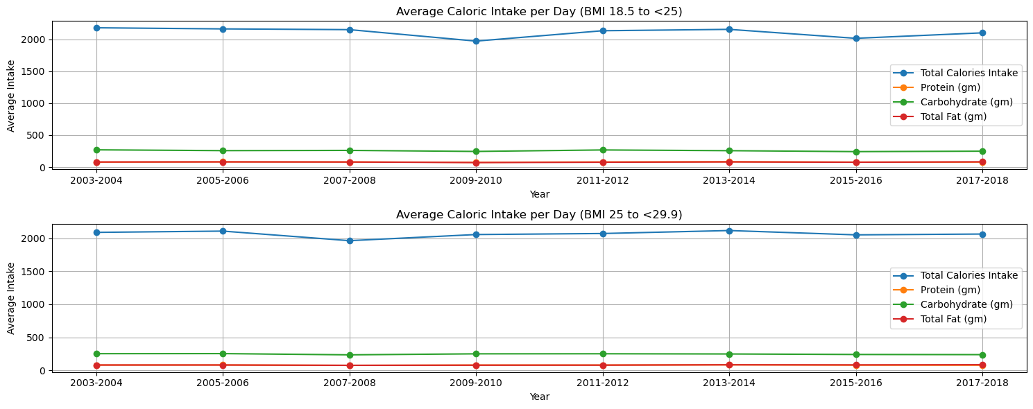
Obesity: The Caloric Plate

Slide 21
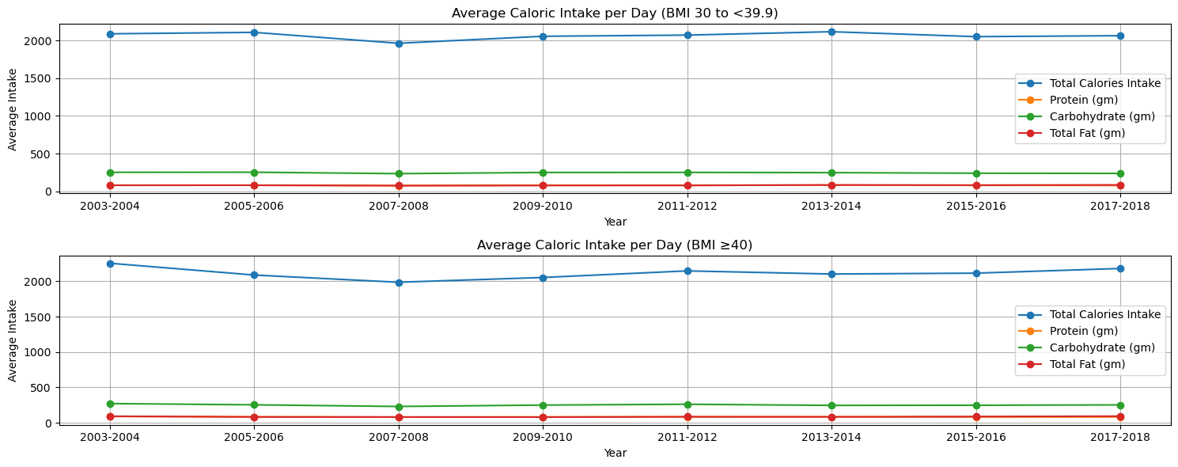
The Caloric Plate Part 2

Slide 22
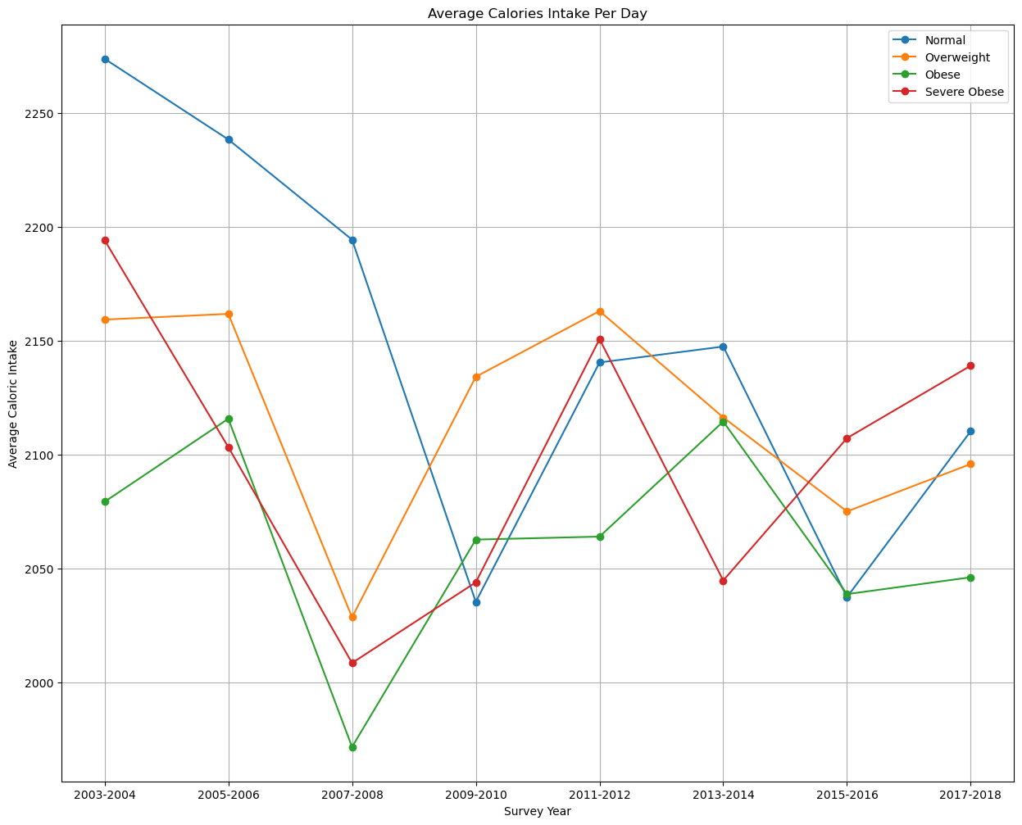
The Caloric Plate Part 3

Slide 23
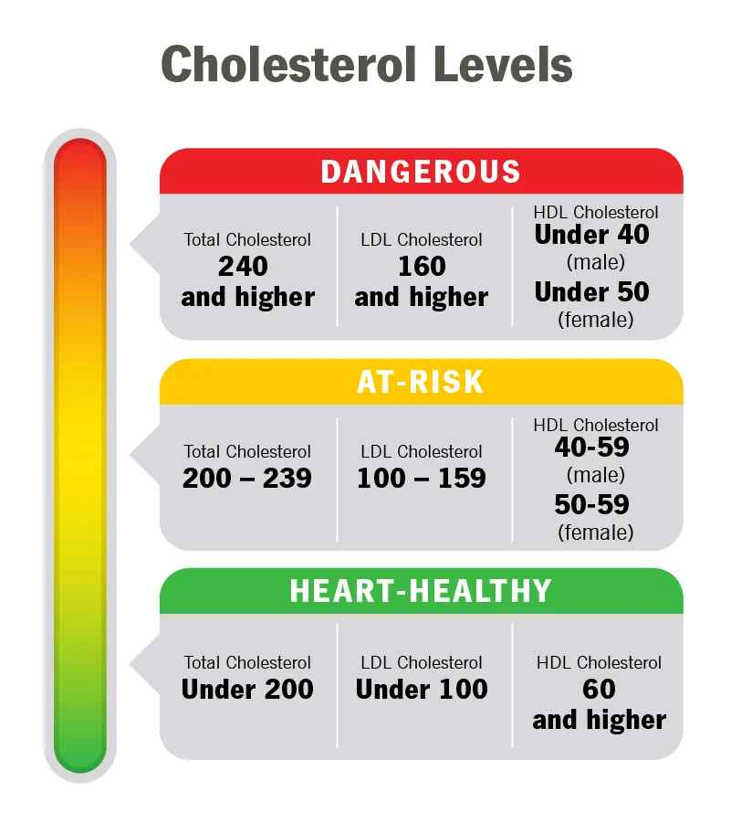
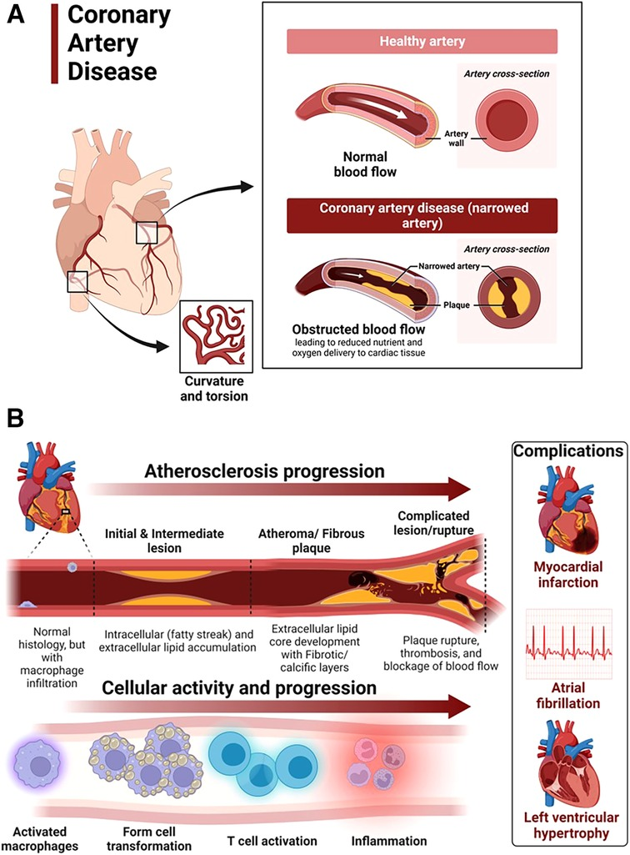
Why Cholesterol Matters?

Slide 24
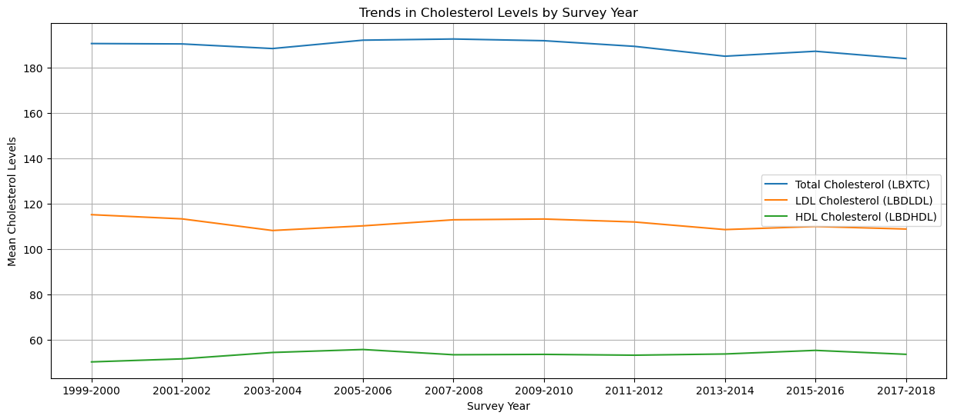
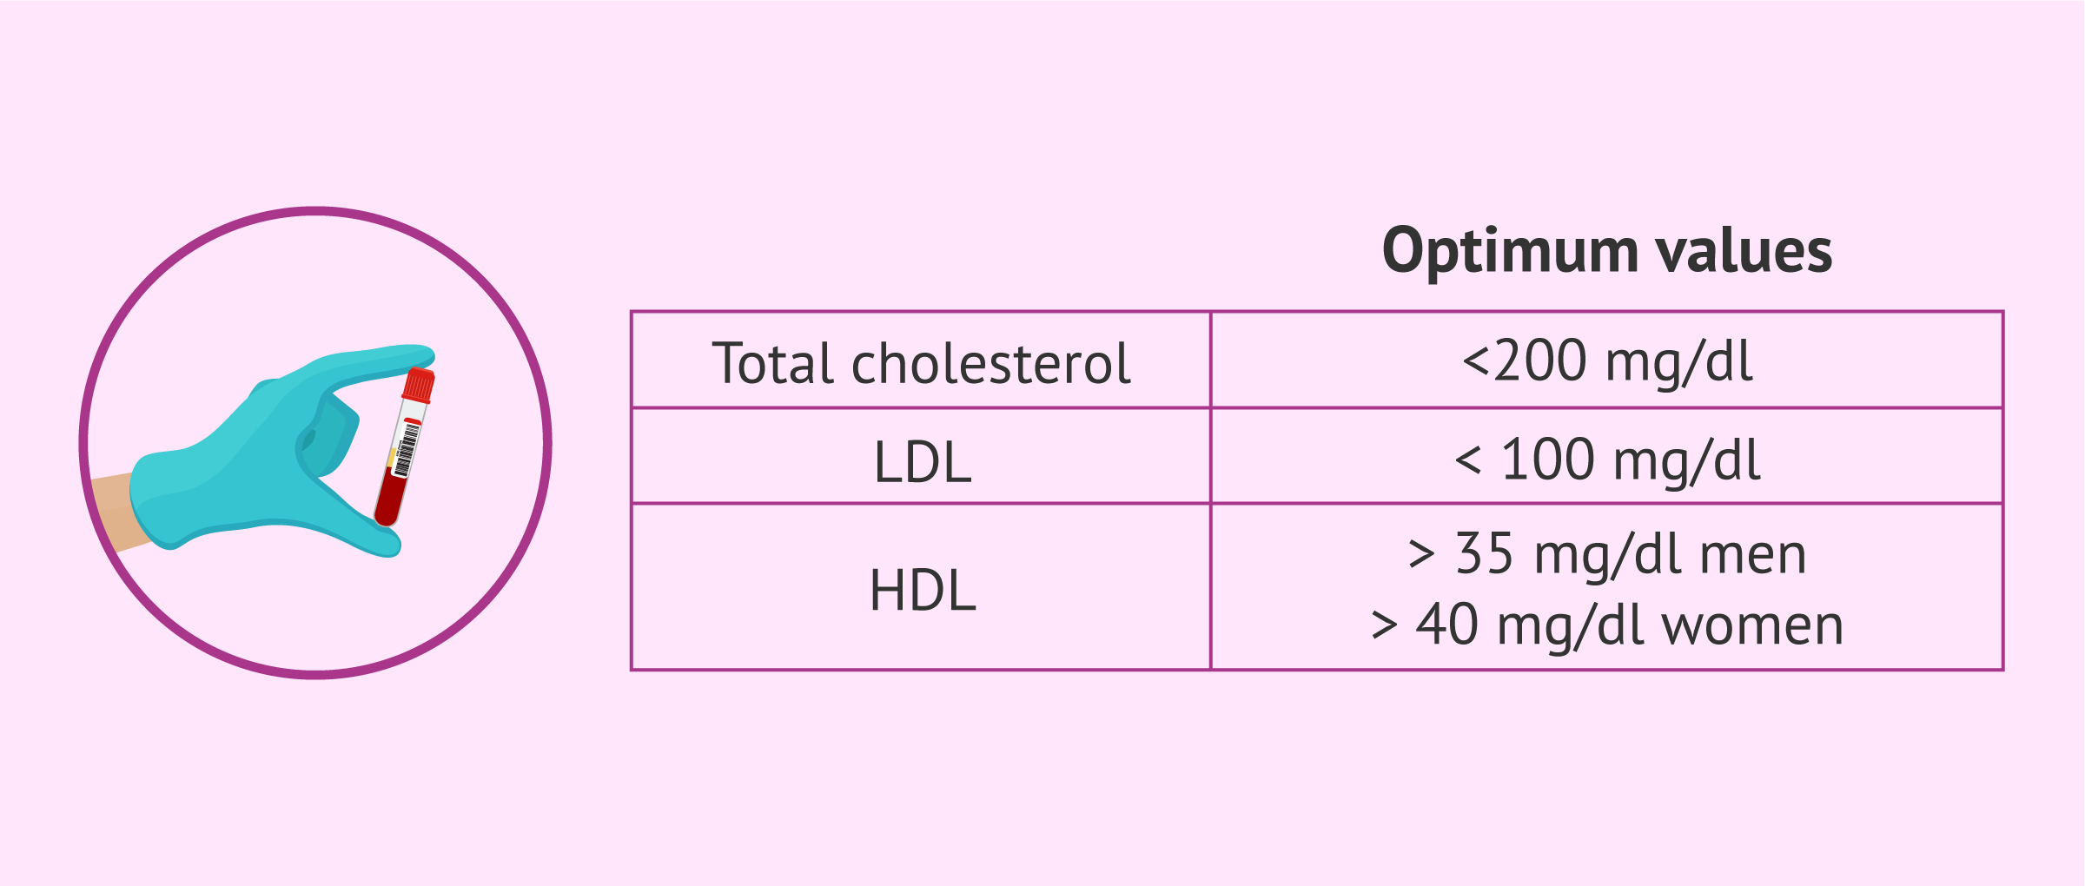
Cholesterol Trends

Slide 25
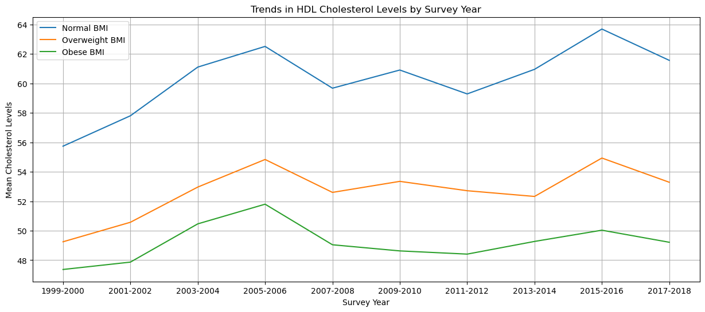
HDL “Good” Cholesterol

Slide 26
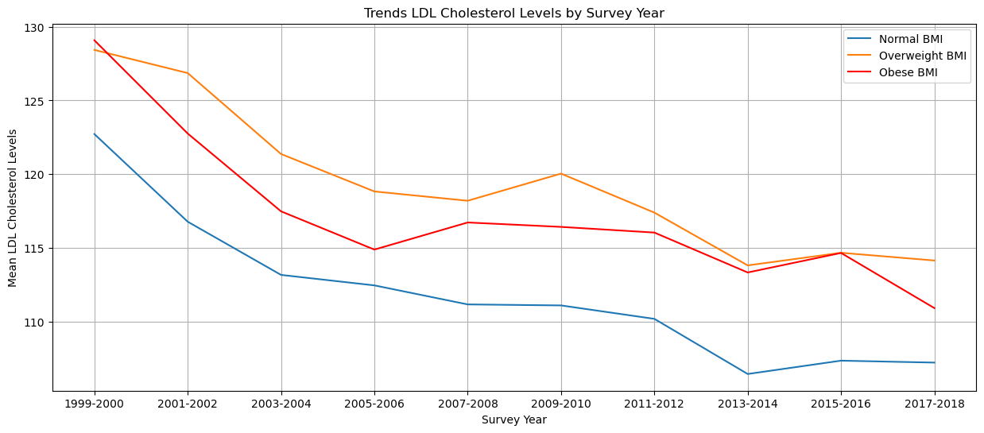
LDL “Bad” Cholesterol

Slide 27
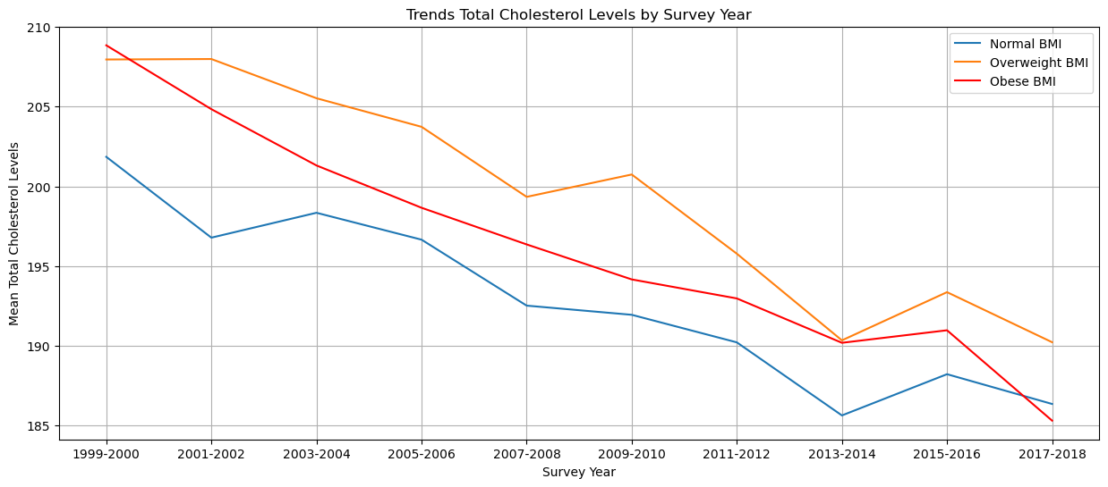
Total Cholesterol

Slide 28
Hypothesis Testing: Anova
Hypothesis Test:
Results:
Null Hypothesis (Ho) : There is no difference in mean BMI among different ethnic groups
Alternative (H1) : There is at least one pair ethnic groups with different mean BMI’s.
BMI vs Ethnic Groups
F-Statistic = 123.124
P-Value = 1.99e- 104
P-value is extremely small there for reject the null hypothesis. There is a difference in mean BMI among different ethnic groups are strongly statistically significant.

Slide 29
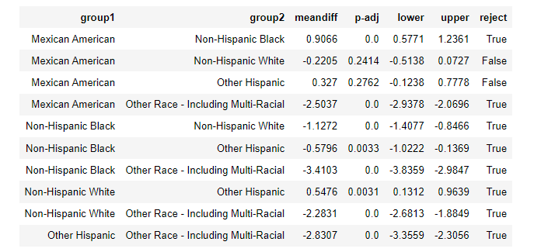
Post-Hoc Test: Tukey’s HSD
Tukey’s Test:
Results:
Mean Diff - is the difference between two groups.
Positive mean diff is the first group has higher average BMI than the second group.
Negative mean diff means that the first group has a lower average BMI than the second group.

Slide 30
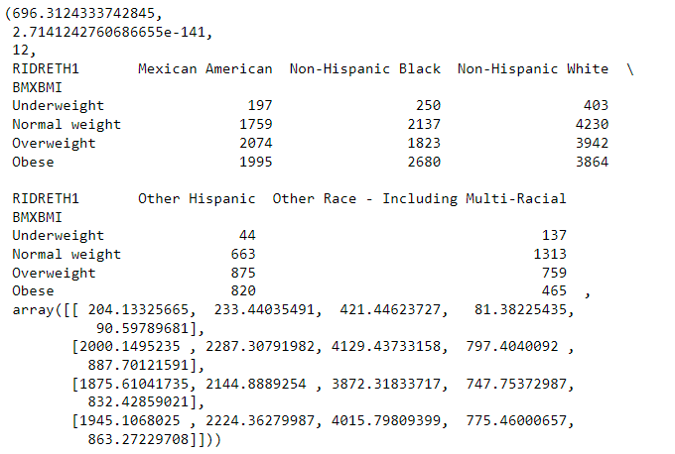
Chi -Square
Results
Significant association between race groups and BMI categories
P-value : 2.71 x 10^-141
Since extremely small p-value we can conclude that there is a significant association between race/ethnicity and BMI categories
Chi-squared Statistic- High 696
Degrees of Freedom 12

Slide 31
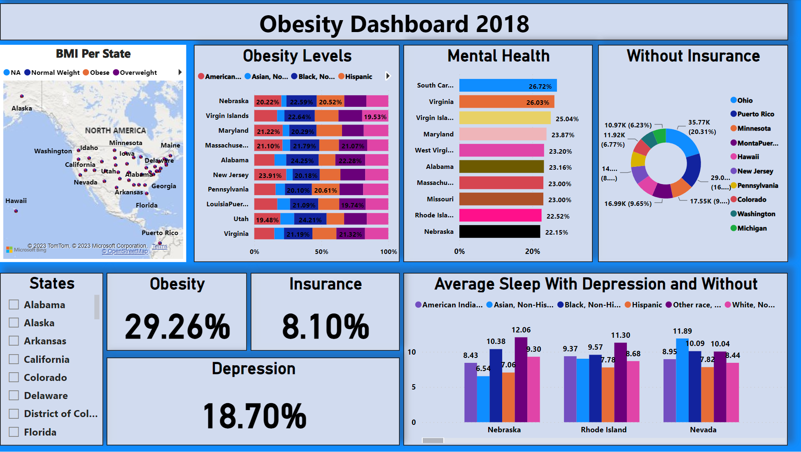
Health Analytic Center 2018

Slide 32
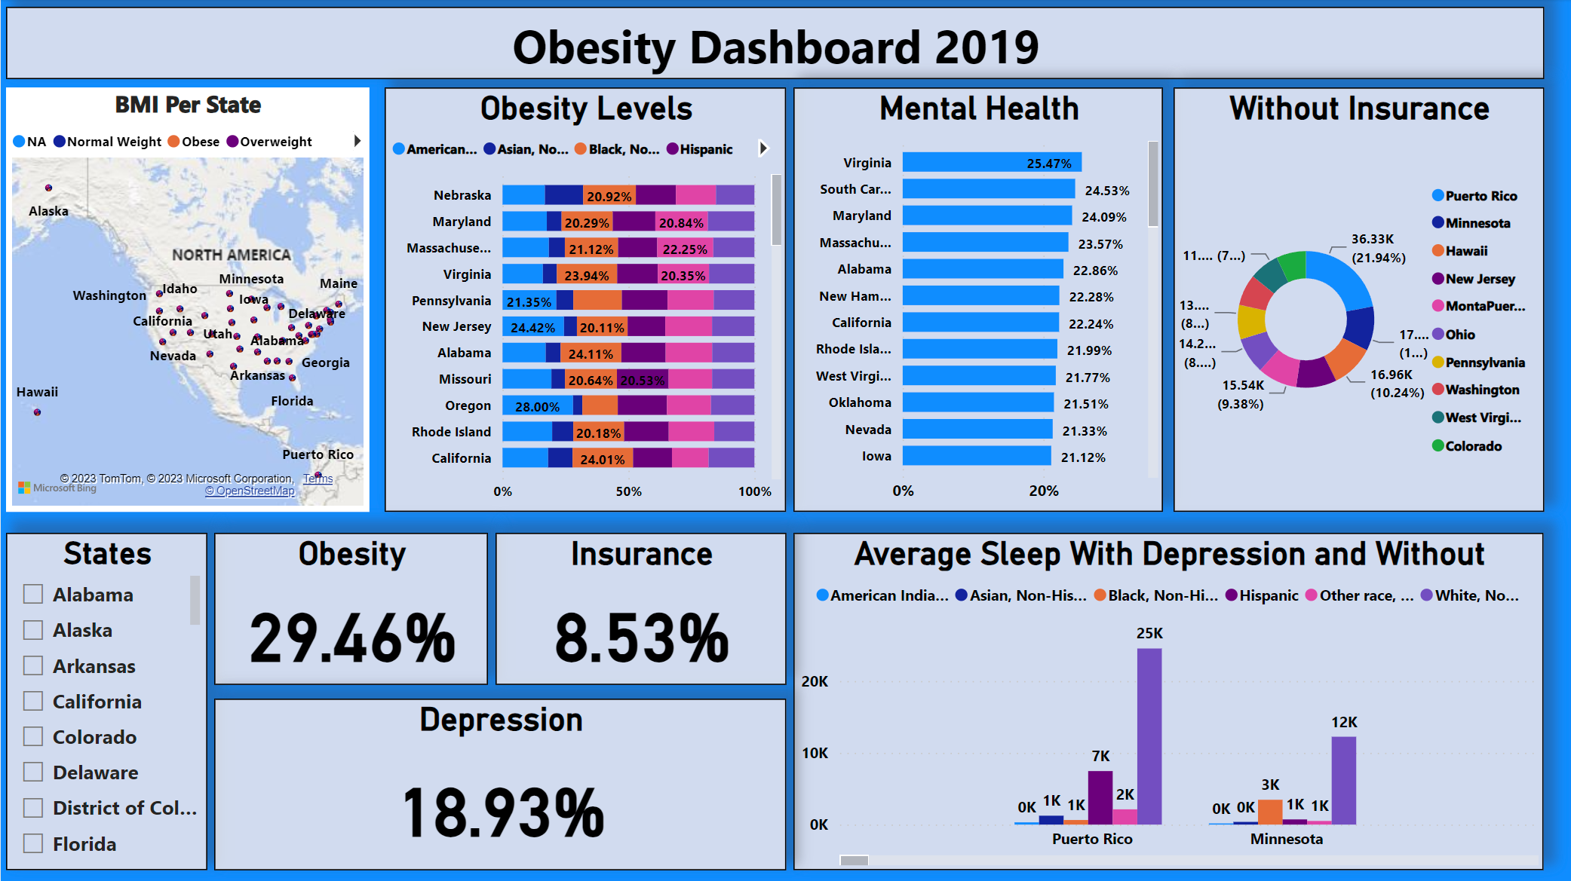
Health Analytic Center 2019

Slide 33
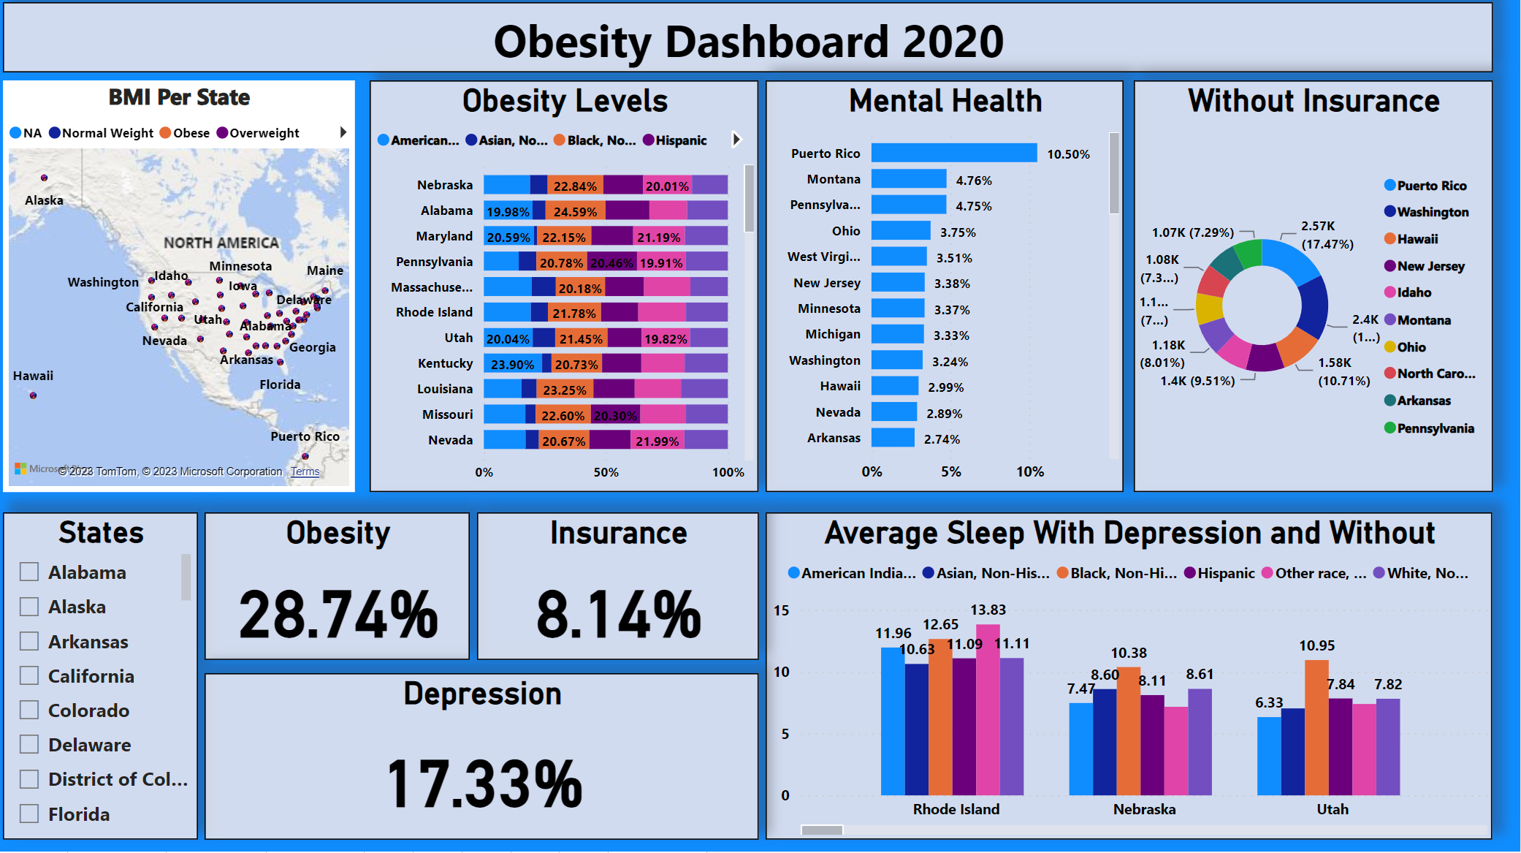
Health Analytic Center 2020

Slide 34
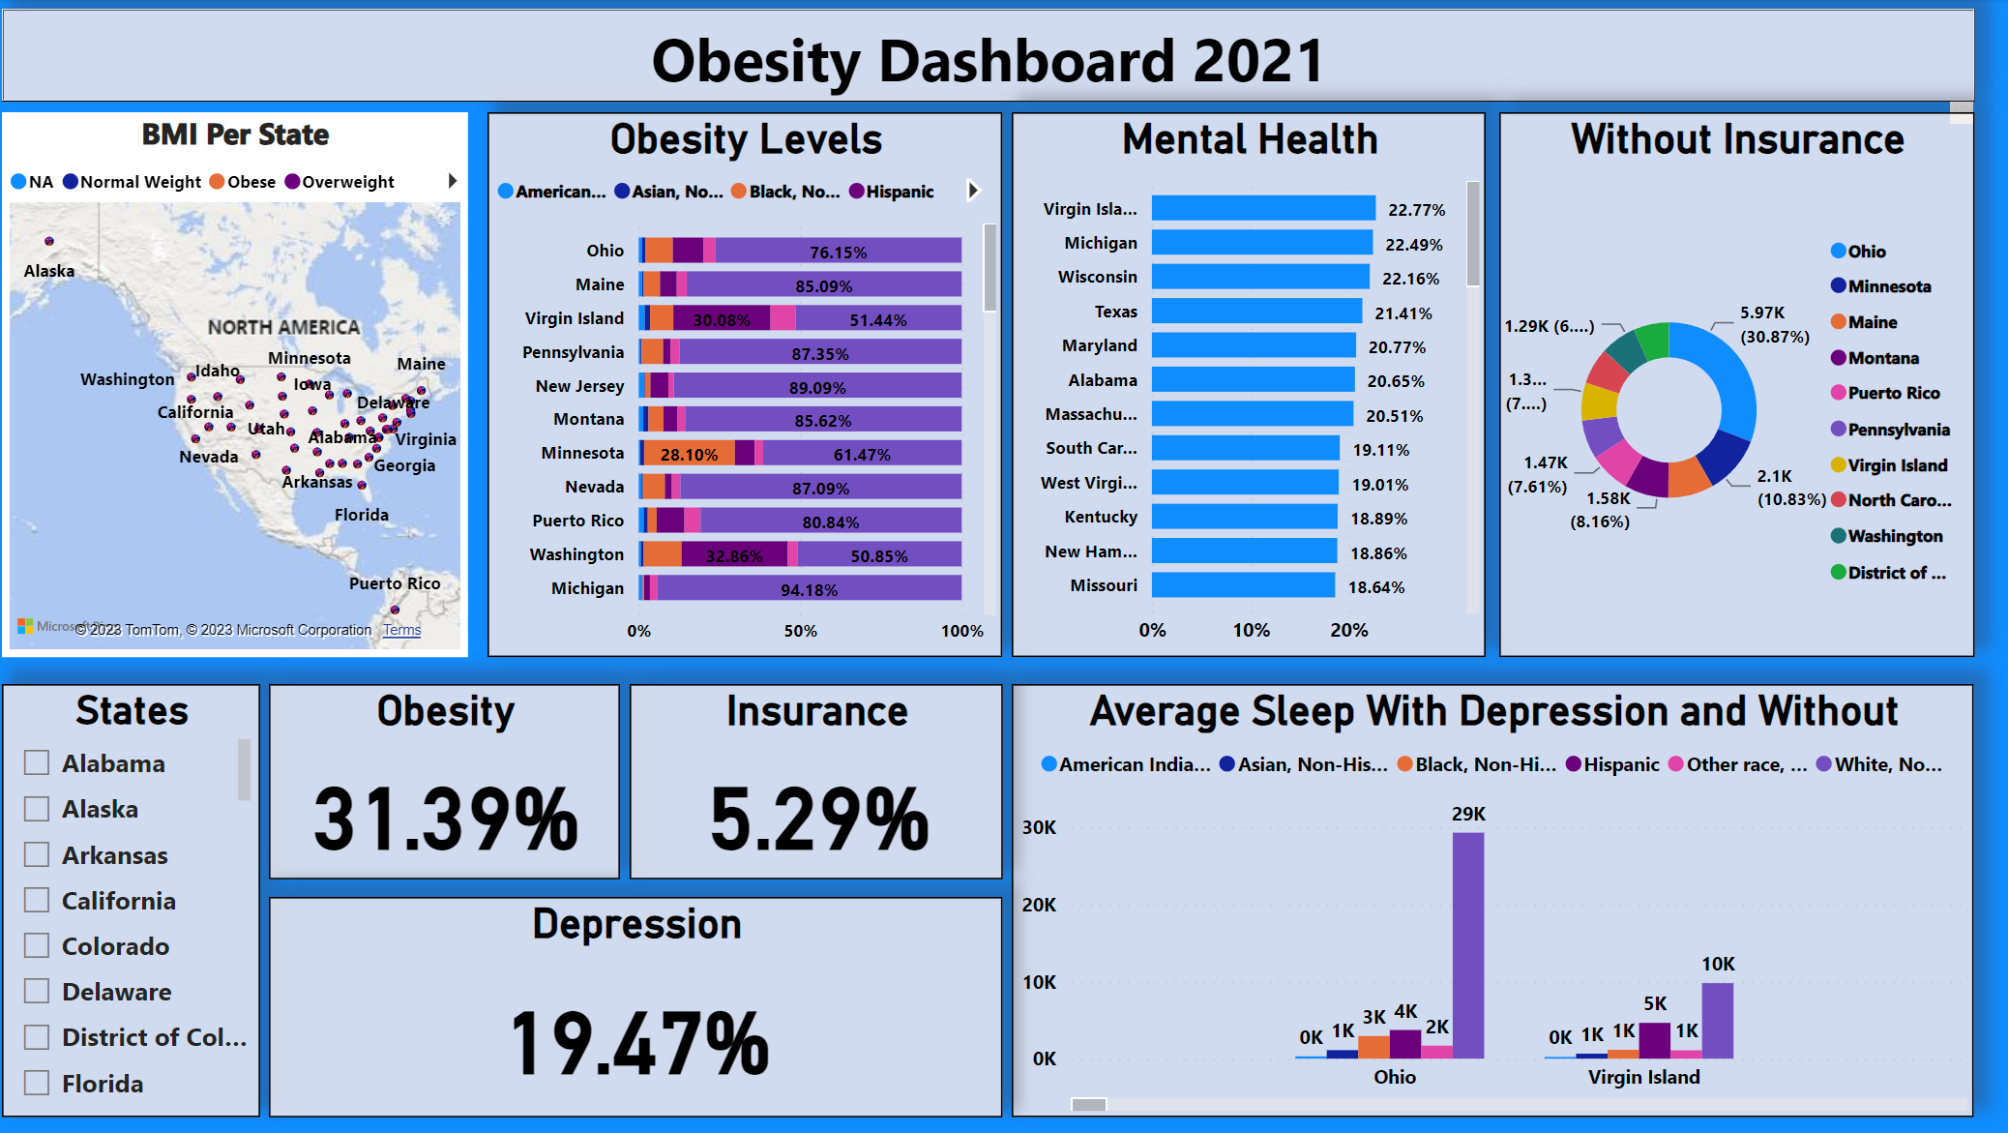
Health Analytic Center 2021

Slide 35
Recommendations
Targeted Health Interventions and Education
Certain ethnic groups show higher or lower BMI. Certain programs can be tailored to those specific groups like physical activity, nutritional education.
Research to Understand Underlying Causes:
Factors contributing to obesity. Studies of dietary habits, social economic status, genetic predispositions, lifestyle factors and access to healthcare
Public Policy:
Promote healthy foods. Accessibility for mental health and access to recreational centers. School based nutritional programs. Regulate food advertising. Increase tax on unhealthy foods.
Community Support:
Promote physical activities. Promote community gardens. Teach kids how to cool.

Slide 36
Special Thanks
Professors
Mentors
Prof. R. Saidi
Data 110 + Math 217
Prof. M. Iapalucci
Data 110 + Data 205
Prof. M. Abdirisak
Data 201
Prof. Alraee Mais
Math 117
Dr. Ami Ostchega PhD
NIH Clinical Research
Dr. Wilfred Kokou Letsou Phd
Sr. Data Scientist

Slide 37
NHANES and BRFSS
Sources
https://wwwn.cdc.gov/nchs/nhanes/search/datapage.aspx?Component=Examination
https://www.cdc.gov/brfss/data_documentation/index.htm

